Slide 1
Community Conversations
Meeting Name
Meeting Date
Last Revised February 2025

Slide 2
Today’s Purpose
Bring more voices into the conversations shaping the future of Midwest Connect.

Slide 3
Agenda
Introduction
Project Overview
Community Discussion
How to Stay Engaged
Note: Throughout the presentation, you will see this symbol, marking an opportunity for group discussion.

Slide 4
Introduction

Slide 5
What have you heard about Midwest Connect?
Notes:
Throughout the presentation

Slide 6
Project Overview

Slide 7
Midwest Connect aims to reestablish passenger rail service across 545 miles connecting the cities of Chicago, Fort Wayne, Columbus and Pittsburgh.

Slide 8
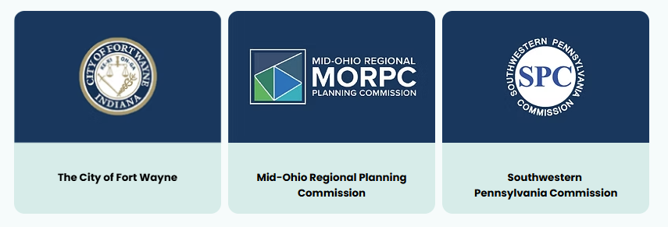
The Midwest Connect Team
The City of Fort Wayne is the lead agency for Midwest Connect.
The City has partnered with regional planning agencies Mid-Ohio Regional Planning Commission (MORPC) and Southwestern Pennsylvania Commission (SPC) for Step 1 of the Corridor ID Program.

Slide 9
Project Progress
Local and regional groups have studied this corridor for more than a decade. The project is now moving through the Federal Railroad Administration’s (FRA) Corridor ID Program, a key step for obtaining federal funding for implementation.

Slide 10
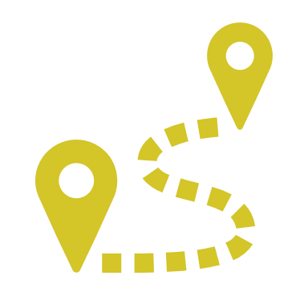
Next Steps
Project Progress
Local and regional groups have studied this corridor for more than a decade. The project is now moving through the Federal Railroad Administration’s (FRA) Corridor ID Program, a key step for obtaining federal funding for implementation.
The City of Fort Wayne received a grant from the FRA to conduct Step 1 of the Corridor ID Program.
Additional funding will be needed to move to Step 2.

Slide 11
Project Cost
The cost to implement the project will be determined in future phases of the project. Much of the funding is anticipated to come from the FRA.
IMPLEMENTATION COST
TBD to be determined

Slide 12
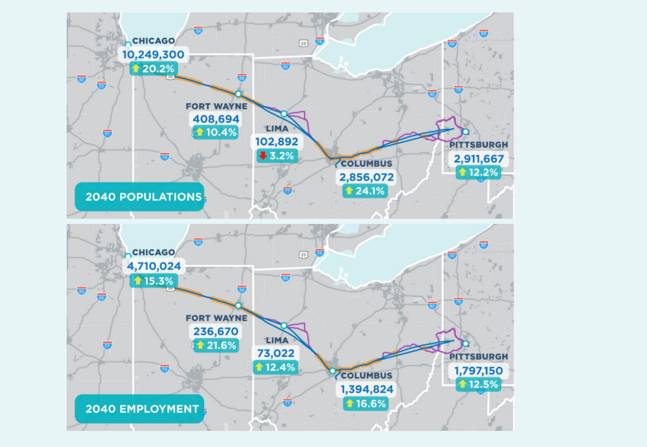
Population & Job Growth
This corridor is expected to see significant population and job growth over time, generating a strong market for passenger rail service.
BY THE YEAR 2040
3 million more people living along the route
1 million new jobs along the route
Source: Rapid Speed Transportation Initiative (RSTI) Existing Conditions & Market Analysis, 2019

Slide 13
What Passenger Rail Can Do

Slide 14
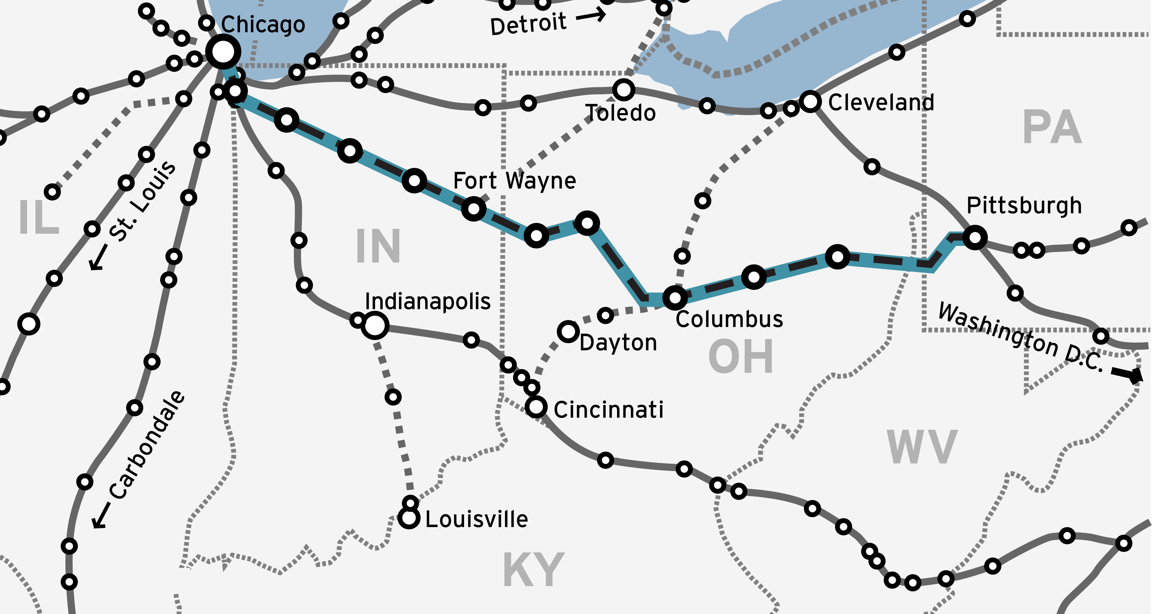
Passenger Rail Network
Planning efforts for several corridors are moving forward at the same time.
Collaboration across the passenger rail network is critical.

Slide 15
Vision Statement – Draft
Midwest Connect will provide safe, efficient and reliable intercity passenger rail service for Chicago, Fort Wayne, Columbus and Pittsburgh and intermediate stations in between.
Because of its combination of frequency, speed and reliability, the Midwest Connect route will serve as the preferred passenger rail route from Chicago to the east coast of the United States.
Note: The project vision and purpose will continue to be revised in later project phases.

Slide 16
Project Purpose – Draft
Connect City to City. Restore passenger rail service connecting Chicago, Fort Wayne, Columbus and Pittsburgh.
Connect Same-Day. Provide a convenient option for same-day travel between Chicago and Columbus, and Columbus and Pittsburgh.
Connect to Top Destinations. Link rural, small, mid-sized, and large cities to more jobs, retail, recreation, health care, leisure, education, entertainment and other destinations.
Connect Efficiently. Maximize the use of existing right of way, rail infrastructure and cost-effective enhancements along the corridor.
Connect Economically. Balance demand and financial return in operational decisions.
Connect Multimodal Options. Provide a travel alternative that is complementary to auto and air travel.
Connect Nationwide. Integrate corridor cities with the larger national passenger rail.
Note: The project vision and purpose will continue to be revised in later project phases.

Slide 17
Opportunities for Public Input
Your input today will help shape the project during early planning.
In later phases, there will be more opportunities to learn more, ask questions and share your thoughts.

Slide 18
Community Discussion

Slide 19
Who can you imagine riding passenger rail in this corridor? Who are they? Where are they going? Why did they choose passenger rail?

Slide 20
How could this project benefit your community?

Slide 21
What ideas do you have for this project? Ways to create a positive rider experience? How to attract future riders?

Slide 22
How would you prefer to be engaged in the future?

Slide 23
Stay Engaged

Slide 24
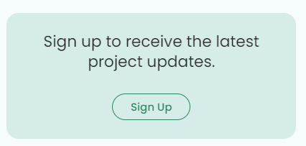
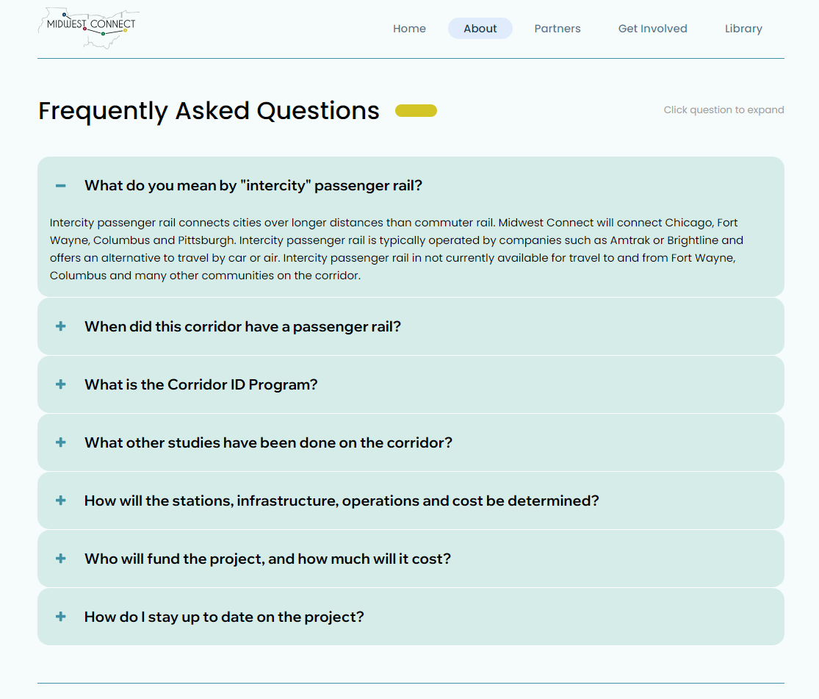
Visit Website & Sign Up
www.midwestconnectrail.com

Slide 25
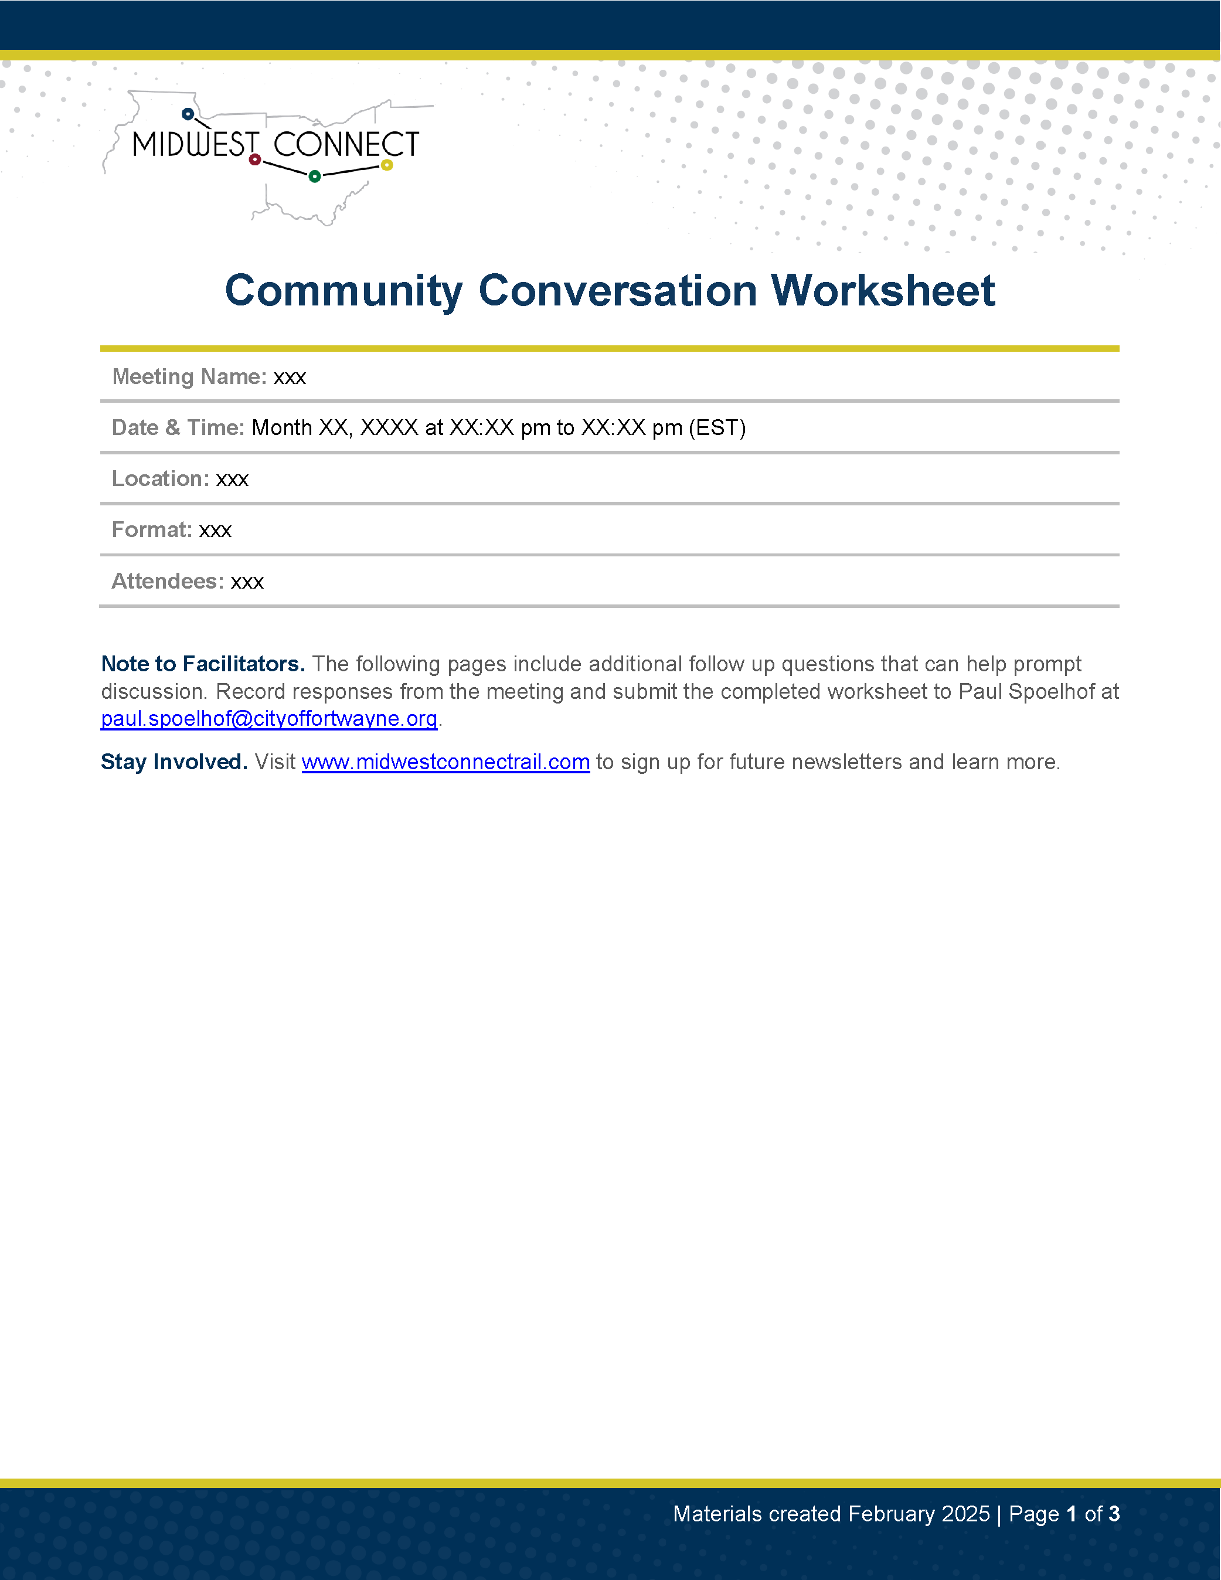
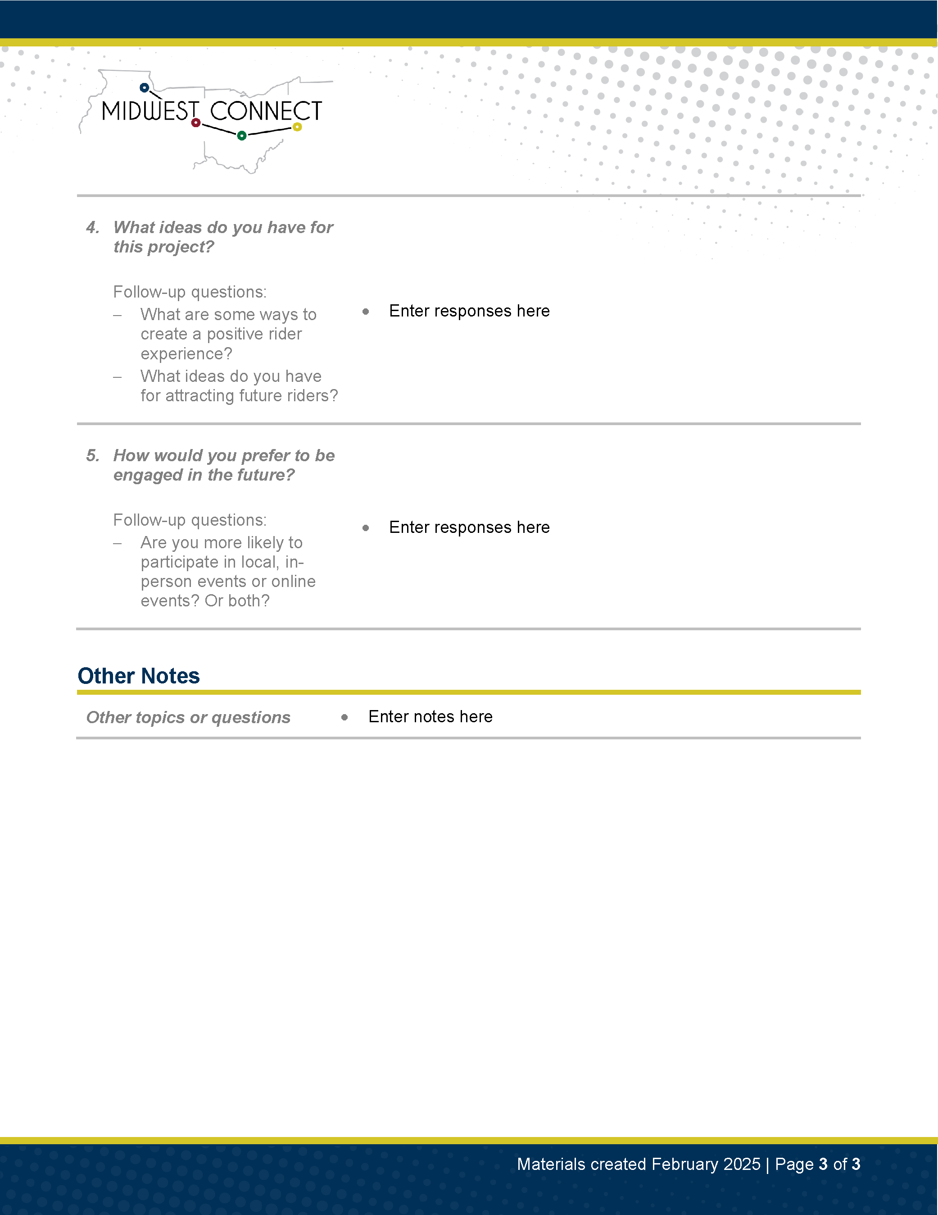
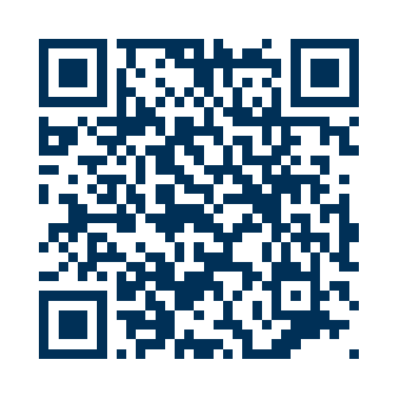
We Want to Hear from You!
Please share your insights from this community conversation with the Midwest Connect team.
Submit the completed worksheet or notes to Paul Spoelhof at paul.spoelhof@cityoffortwayne.org
Scan the QR code or visit: http://www.midwestconnectrail.com/get-involved

Slide 26
Project Contacts
Paul Spoelhof Planning Director, City of Fort Wayne paul.spoelhof@cityoffortwayne.org
Russell Garriott Senior Planner, City of Fort Wayne russell.garriott@cityoffortwayne.org

